Slide 1
Sprint Review
[Project Name]

Slide 2
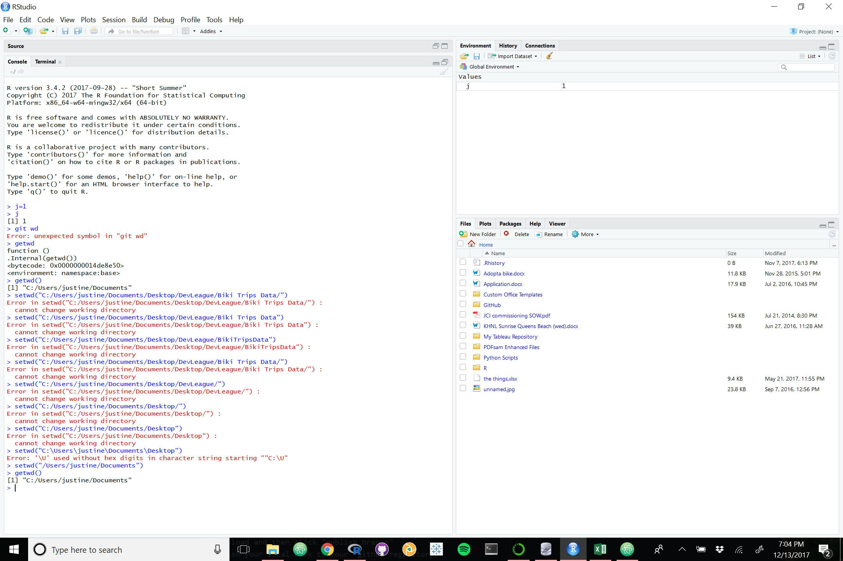

Slide 18
Fin

